Slide 1


Java Basics
Fast-track review of the Core Concepts of Java programming language

Slide 2
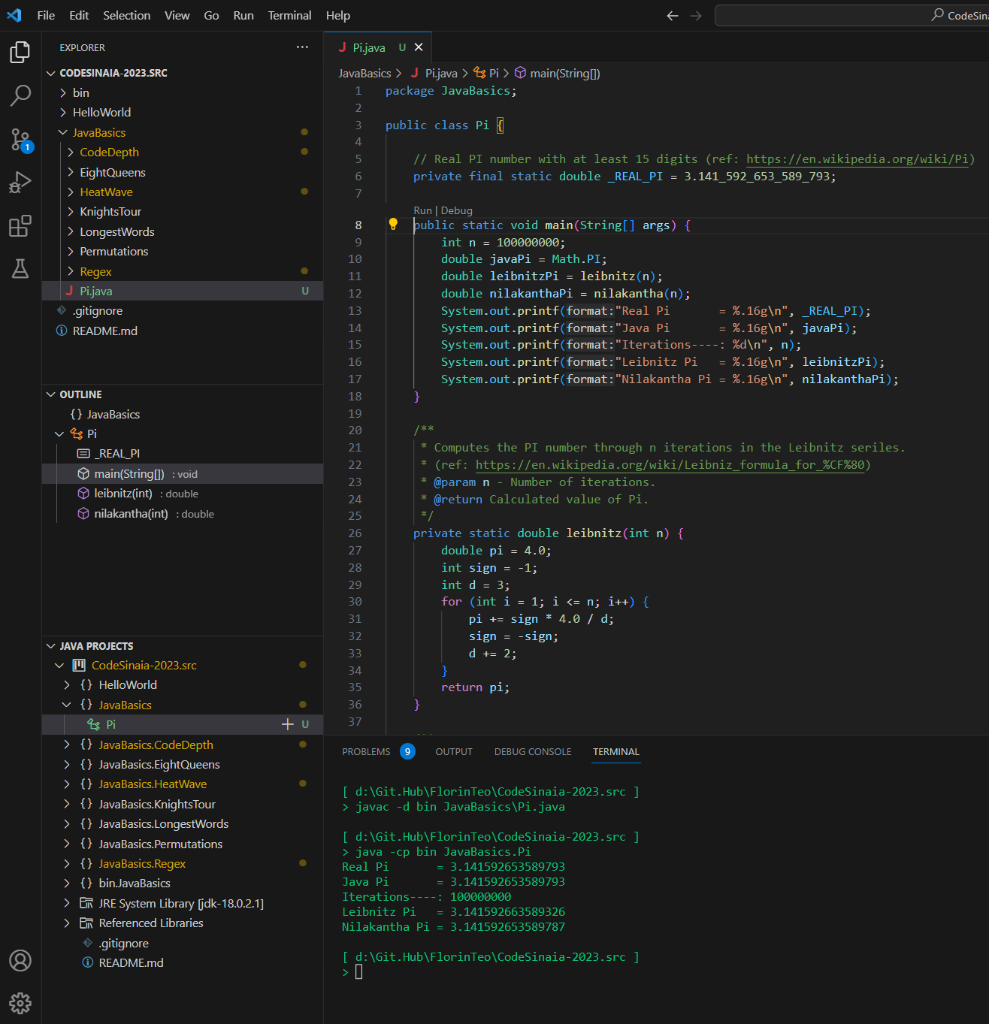
VS Code : Integrated Dev Environment
VSCode works on folders and files in most generic way.
The folder loaded in VSCode is called the Project folder.
It supports source control systems such as Git.
It can compile, run and debug programs from source code files (depending on the installed extensions).
It has a marketplace of extensions for many programming languages. (Extensions Pack for Java is one of the many)
It allows editing files in the main editor view
It has a navigation panels showing the content in various ways:
EXPLORER: hierarchical view of folders, subfolders, files.
OUTLINE: structure of the file loaded in the editor,
JAVA PROJECTS: packages and classes for folders contains Java code. (each sub-folder in the Project folder is a Java project)

Slide 3
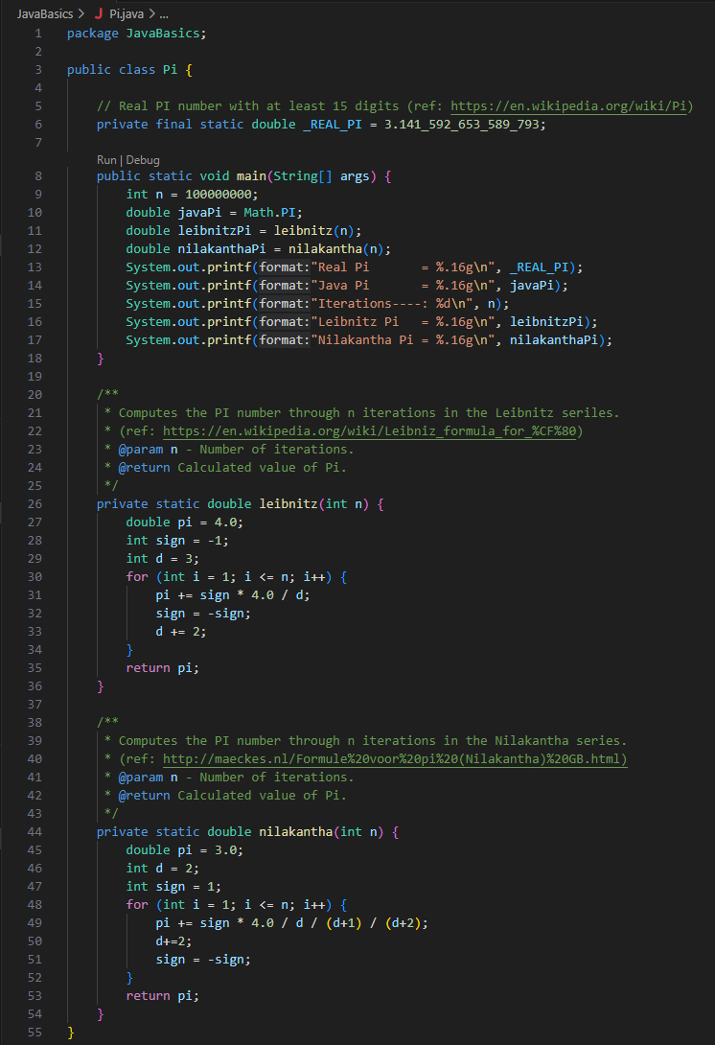
Anatomy of a Java Source File
A Java Source File is a text file with extension .java
The sub-folder containing the file is the Java package where the java file lives.
Java code is organized in classes. A Java Source File contains exactly one Class.
The class has a Class name which matches the name of the Source File.
The text in between { and } immediately following the class name is the Class body or class definition.
Styling: Class names typically start with a Capital letter.
Styling: The text within the class body has to be indented one TAB to the right from the line containing the class name.
A Java Class contains one or more methods.
Each method has a method name, which is unique within the class.
Java is a case-sensitive language, capitalization matters: "This" is totally different than "tHis" or "THIs".
The line containing the method name is called the method signature.
The text in between { and } immediately following the method signature is the method body.
Styling: Method names typically start with lower-case letter.
Styling: The text within the method body has to be indented one TAB to the right from the method signature line.
In order to run the code in a class, the class should contain a main method having a special signature.
A Java method contains in its body one or more statements.
Statments can be composite: made up of multiple other statements, like if(), for(), while()).
A non-composite statement ends with a ;
Like in most other programming languages, white space characters are ignored.
Single-line (//...) or multi-line (/* ... */) comments are just like in C, C++ or C#.

Slide 4
 Stand-up break
A Java program is stored in a class.
Within a class there are one or more methods.
At a minimum, a complete program requires a special method called main.
Inside a method like main, there is a series of statements.
Each statement represents a single command for the computer to execute.
Load the file Pi.java in VS Code and run it.
Notes:
Deliberately repeated from previous slide set (do this warmup exercise without looking at notes from the previous class).
Orange: “class”
Green: “method”
Blue: “main”
Brown: “statement”

Slide 5
String literals
Strings: A sequence of characters that we “string” together
You can specify a “string literal” in your program by surrounding text in quotation marks (").
Can you identify the string literal in Pi.java code?
Beware when copying and pasting quotation marks between Office applications such as PowerPoint or Word and VSCode!
In Office applications, quotation marks are by default replaced with prettier symbols. They look similar, but do not have the same meaning in Java.
“ and ” are not the same as ".

Slide 6
Escape sequences
What happens if you want to print a string containing a quotation mark to the console?
Try adapting your HelloWorld program to also print the following: I said "hello"
We escape the quotation symbol with a backslash (‘\’)
What if you want to display the backslash symbol?
Complete description of escape sequences:
http://docs.oracle.com/javase/tutorial/java/data/characters.html
 | System.out.println("I said \"hello\""); | I said "hello"
 | System.out.println("I said \\hello\\"); | I said \hello\

Slide 7
System.out.println
Your HelloWorld project contains “System.out.println” within one or more statements.
Soon you’ll understand every part of this, but for now it is another “magical incantation” that can be used to display a string on the console.
System.out.println();
Prints a single empty line
System.out.println("Hello, world!");
Prints a line containing the text “Hello, world!”

Slide 8
print versus println
System.out.println actually does two things:
Prints a string to the console
Advances to the next line
System.out.print only does (1)
1 | System.out.print("Hello World!");
2 | System.out.print("\tAnd now ...");
3 | System.out.println();
3 | System.out.println("Let's start coding.");
Hello World! And now ...
Let's start coding.
Notes:
Go through this on the whiteboard showing the location of the cursor as a caret

Slide 9
 print versus println (3 minutes)
What does the following code cause to be displayed in the console?
Use VSCode to write and run this code and find your answer.
1 | System.out.print("To be ");
2 | System.out.print("or not to be.");
3 | System.out.print("That is");
4 | System.out.println("the question.");
5 | System.out.print("This is");
6 | System.out.println(" for the whole family!");
To be or not to be.That isthe question.
This is for the whole family!
Notes:
Go through this on the whiteboard showing the location of the cursor as a caret

Slide 10
Identifiers and keywords
Identifiers are the words used to name parts of a Java program
Must start with a letter, can be followed by any number of letters or digits
The dollar sign (‘$’) and underscore (‘_’) character are also letters, space character (‘ ‘) is not.
Remember, Java is case sensitive!
By convention, we use identifiers beginning with an uppercase character for classes, and identifiers beginning with a lowercase character for methods.
Keywords are a set of reserved pre-defined words having a special meaning within the language.
Full list of the reserved keywords: here.
Identifier
A name given to an entity in a program, such as a class or method.

Slide 11
 Legal or illegal? (2 minutes)
Sort the following into two groups: “legal identifiers” and “illegal identifiers”. Use eclipse to check your answer.
first
hiThere
numStudents
two+two
_count
2by4
MAX_COUNT
two_plus_two
hi there
hi%there
$2donuts
public
☑
☑
☑
☒
☑
☒
☑
☑
☒
☒
☑
☒
Notes:
Create a copy of the “main” method and change its name.

Slide 12
Readability
Whitespace is not significant to the compiler
It is used to make programs easier to read for humans
Can you tell quickly what this program does?
How about now?
public class Program{public static void main(String[] args){System.out.print("How short I am!\t");System.out.print("What do I do?");}}
public class Program {
public static void main(String[] args){
System.out.print("How short I am!\t");
System.out.println("What do I do?");
}
}

Slide 13
Comments
Can be used to make your code even more readable
Two types of comments:
Become more useful in larger, more complex programs
Add comments to your project code!
Add a comment to your HelloWorld project
// This is a single line comment. Text is ignored from the // marker till the end of the line
System.out.println("This message will print!");
/* This is a multi-line comment. Text is ignored from the /* marker till the first * / marker that follows
System.out.println("This message never prints!“);
*/
Comment
Text that programmers include in a program to explain their code. The compiler ignores comments
Notes:
Teachers and TAs like comments when grading projects, or more complicated homework/test questions!

Slide 14
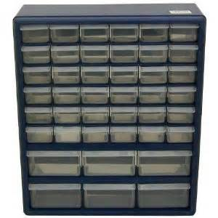
Java Variables
What if we could instruct Java:
Each time you see the name pi in an expression, we mean the value 3.1415926 of type double.
Each time you see the name r in an expression, we mean the value 8.5213 of type double.
Then, our code would look much cleaner:
1 | System.out.println("L=" + 2*pi*r); | L=53.54090604476
2 | System.out.println("A=" + pi*r*r); | A=228.1190613396067
3 | System.out.println("D=" + 2*r); | D=17.0426
4 | System.out.println("4A/L=" + 4*pi*r*r/2*pi*r); | 4A/L=17.0426
Variable
A memory location with a name and a type that stores a value.
pi
Imagine a big storage organizer with many drawers. The value 3.1415926 is stored in one of these drawers labeled pi. Each time we ask for pi, Java opens that drawer, peeks inside, and tells us the value.
The organizer is the computer memory. The drawer is the variable.
Notes:
2-1.Variables @ 4

Slide 15
Variables declaration and assignment
Declaration
A request to set aside a new variable with a given name and type.
 Legal or illegal?
Statement type | Syntax | Examples
Declaration | <type> <name>; | double pi; int studentId; String studentName;
Assignment | <name> = <expression>; | pi = 3.1415926; studentId = 8122; studentName = "John Doe";
1 | int i;
2 | double d;
3 | char c;
4 | String s;
5 | int 2i;
6 | int i2;
7 | double _$2;
8 | char c;
9
10 | i = "abc";
11 | d = 2.71828;
12 | c = (byte) 65.32;
13 | s = d + "abc";
14 | i2 = 7 + (int)d + s;
15 | _$2 = 3 / 2 + (int)c;
☑
☑
☑
☑
☒
☑
Variable names are identifiers. Same rules apply.
Not all variable assignments or expressions are legal. The type of the expression has to evaluate to the type of the variable.
Compiler error: Variables declared and not assigned are called uninitialized.
Compiler error: Two variables cannot have the same name within the same method.
☑
☒
☒
☑
☑
☑
☒
☑
Notes:
2-1.Variables @ 6
Explain implicit casting: char c = (byte) 65.32;

Slide 16
Variables declaration and assignment
Let’s understand better the assignment statement:
operand
operand
accessors, post-increment | () [] . , ++ --
pre-increment, unary | + - ++ -- ~ !
typecast, object creator | () new
multiplicative | * / %
additive | + -
shift | << >> >>>
relational | < > <= >= instanceof
equality | == !=
bitwise AND | &
bitwise exclusive OR | ^
bitwise inclusive OR | |
logical AND | &&
logical OR | ||
ternary | ?:
assignment | = += -= *= /= %= &= ^= |= <<= >>= >>>=
<name> = <expressions>;
operator
top-down precedence
Assignment is an operator, with two operands: a left-hand-value (lhv) and a right-hand-value (rhv).
It has the lowest precedence in the operator precedence table (all other operators are evaluated first).
The rhv is stored in a memory location and the lhv name is the variable used to reference that location.
It is evaluated to the rhv. Yes, assignments can be used in expressions also, but not a good practice (code hard to read, good source of bugs).
Notes:
2-1.Variables @ 7
Emphasize how assignment operator is different than the algebraic equality statement they must have seen in math.

Slide 17
Assignment Operators
accessors, post-increment | () [] . , ++ --
pre-increment, unary | + - ++ -- ~ !
typecast, object creator | () new
multiplicative | * / %
additive | + -
shift | << >> >>>
relational | < > <= >= instanceof
equality | == !=
bitwise AND | &
bitwise exclusive OR | ^
bitwise inclusive OR | |
logical AND | &&
logical OR | ||
ternary | ?:
assignment | = += -= *= /= %= &= ^= |= <<= >>= >>>=
Modifying the value of a variable can be done in a compact way, via special assignment operators:
+= -= *= /= %=
top-down precedence
The assignment… | … is equivalent to:
x = x * y; | x *= y;
x = x / y; | x /= y;
x = x % y; | x %= y;
x = x + y; | x += y;
x = x – y; | x -= y;
This code… | … is equivalent to this code
int minutes; | int minutes;
minutes = 60; | minutes = 60;
minutes = minutes * 24; | minutes *= 24;
System.out.println(minutes); | System.out.println(minutes);
Notes:
2-2.Variables in Expressions @ 5

Slide 18
Unary Operators
accessors, post-increment | () [] . , ++ --
pre-increment, unary | + - ++ -- ~ !
typecast, object creator | () new
multiplicative | * / %
additive | + -
shift | << >> >>>
relational | < > <= >= instanceof
equality | == !=
bitwise AND | &
bitwise exclusive OR | ^
bitwise inclusive OR | |
logical AND | &&
logical OR | ||
ternary | ?:
assignment | = += -= *= /= %= &= ^= |= <<= >>= >>>=
The value of a variable can be incremented or decremented before or after being evaluated via the pre-increment and post-increment unary operators:
++name –-name name++ name--
top-down precedence
These assignments… | … are equivalent to:
x += 1; y = x; | y = ++x;
x -= 1; y = x; | y = --x;
y = x; x += 1; | y = x++;
y = x; x -= 1; | y = x--;
This code… | … is equivalent to this code
int minutes = 41, seconds = 59; | int minutes = 41, seconds = 59;
seconds = seconds + 1;
minutes = minutes + seconds / 60; | minutes += ++seconds / 60;
seconds = seconds % 60; | seconds %= 60;
System.out.println(minutes + ":" + seconds); | System.out.println(minutes + ":" + seconds);
Notes:
2-2.Variables in Expressions @ 6

Slide 19
Typecasting operator
Syntax: type surrounded by round parenthesis.
Operand: Applies to the value to its right.
Precedence: Applies after parentheses and before additive and multiplicative operators
In the expressions below, which ones are the operands for the typecast operator? What’s the result of evaluation?
accessors, post-increment | () [] . , ++ --
pre-increment, unary | + - ++ -- ~ !
typecast, object creator | () new
multiplicative | * / %
additive | + -
shift | << >> >>>
relational | < > <= >= instanceof
equality | == !=
bitwise AND | &
bitwise exclusive OR | ^
bitwise inclusive OR | |
logical AND | &&
logical OR | ||
ternary | ?:
assignment | = += -= *= /= %= &= ^= |= <<= >>= >>>=
top-down precedence
operator
operand
(double)90
= 90.0
(int)(6.4/4 + 2.5)
= 4
(int)6.4/4 + 2.5
= 3.5
(double)(int)6.4/4 + 2.5
= 4.0
Notes:
2-3.Typecasting @ 5

Slide 20
Strings in expressions
+ is the only operator accepting a String value as operand. In this case it will do string concatenation.
If only one of the operands of + is a String, the other operand is converted to a string literal.
The result of a + operation involving String operand(s) is a value of type String.
Using String as an operand for any other operator results in a compiler error.
String Concatenation
Combining several strings into a single string, or combining a string with other data into a new, longer string.
System.out.println("Hello" + "World!"); | HelloWorld!
System.out.println("Hello" + ' ' + "World" + (char)33); | Hello World!
System.out.println("An int has " + 1 + 6 + " bits."); | An int has 16 bits.
System.out.println((4 * " quarters") + " = one dollar"); | Error: The operator * is undefined for the argument type(s) int, String
System.out.println((920 + 2) * 1e-2 + "." + (2000 + 45 / 3)); | 9.22.2015
Notes:
2-3.Typecasting @ 6

Slide 21
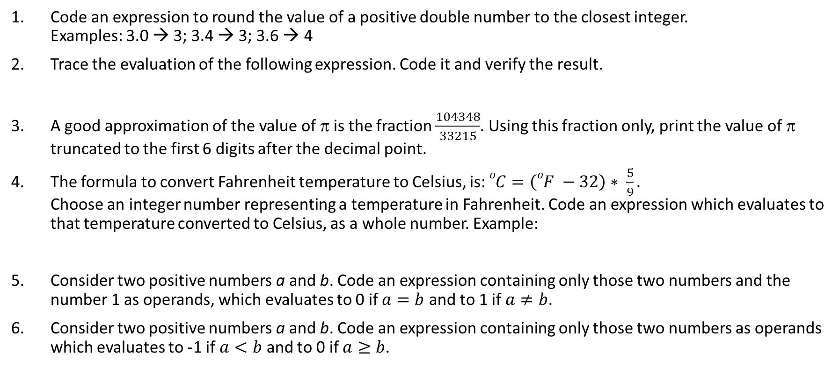

 Brain Teasers Break
Code an expression to round the value of a positive double number to the closest integer. Examples: 3.0 → 3; 3.4 → 3; 3.6 → 4
Trace the evaluation of the following expression. Code it and verify the result.
A good approximation of the value of π is the fraction $\frac{104348}{33215}$. Using this fraction only, print the value of π truncated to the first 6 digits after the decimal point.
The formula to convert Fahrenheit temperature to Celsius, is: $oC=\left(oF −32\right)∗ \frac{5}{9}.$ Choose an integer number representing a temperature in Fahrenheit. Code an expression which evaluates to that temperature converted to Celsius, as a whole number. Example:
Consider two positive numbers a and b. Code an expression containing only those two numbers and the number 1 as operands, which evaluates to 0 if $a=b$ and to 1 if $a≠b$.
Consider two positive numbers a and b. Code an expression containing only those two numbers as operands which evaluates to -1 if $a<b$ and to 0 if $a≥b$.
(char)80 + ( "I = " + 355 / (float)( 2 * 55 + 3. ) )
System.out.println(60+"F = "+(int)((60-32)*5./9)+"C");
60F = 15C
60 $oF$
Notes:
URL Decode: 1)+(int)(x%2B.5)%0A2)+PI+%3D+3.141593%0A3)+(int)((104348%2F33215.)*1000000)%2F1000000.%0A4)+-40%2B%E2%80%9DF+%3D+%E2%80%9C%2B(int)((-40-32)*5.0%2F9)+%2B+%E2%80%9CC%E2%80%9D%0A5)+1-a%2Fb*b%2Fa%0A6)+(0+-+a%25b%2Fa)%0A

Slide 22
Objects
We learned so far to manipulate:
Data - evaluate expressions and store the result in variables.
Code - write methods taking input parameters and producing a return value.
Whenever we start working with new kinds of data (integers, reals, text, etc.), we find ourselves writing methods that operate on that data
Let’s combine the data and the operations!
Object
A programming entity that contains state (data) and behavior (methods)
Notes:
3-1.Objects and Scanner @ 3
What are the primitive types that we have learnt? int, char, double, Boolean
What is a “variable”? A memory location with a name and a type that stores a value.
What is “expression evaluation”? The process of obtaining the value of an expression.

Slide 23
Classes
We met the concept of a “class” before:
Class
A unit of code that is the basic building block of Java programs
A more accurate definition: classes describe new types of objects.
Class
A category or type of object
A class is like a “blueprint” of what an object looks like.
You give Java the blueprints and then ask it to create instances (objects) that conform to the blueprint.
Notes:
3-1.Objects and Scanner @ 4

Slide 24

Understanding objects
So … a class is a “blueprint” which is used to create instances or objects.
Are there classes we can use already? How?
Java comes with a large set of predefined classes. We’ll learn how to use one such class called Scanner. It allows us to provide input to a running program.
We’ll learn of the class constructor operator new.
Can we define our own classes and use them? How?
We’ll learn how to create, instantiate and use our own classes in a future unit.
Notes:
3-1.Objects and Scanner @ 5

Slide 25
Constructors
accessors, post-increment | () [] . , ++ --
pre-increment, unary | + - ++ -- ~ !
typecast, object creator | () new
multiplicative | * / %
additive | + -
shift | << >> >>>
relational | < > <= >= instanceof
equality | == !=
bitwise AND | &
bitwise exclusive OR | ^
bitwise inclusive OR | |
logical AND | &&
logical OR | ||
ternary | ?:
assignment | = += -= *= /= %= &= ^= |= <<= >>= >>>=
Most objects are created by calling a special method known as a constructor. This is done by using the new operator.
top-down precedence
If a class is like a “blueprint” then calling a constructor is like sending an order to the factory: It will follow the blueprint and create an actual object that you can use in your program.
Constructor (Construct)
A method that creates and initializes an object. Objects in Java programs must be constructed before they can be used
Notes:
3-1.Objects and Scanner @ 6
Strings are special and don’t need an explicit call to the constructor; we’ll learn about them next lesson.

Slide 26
Calling a constructor
Constructors are called using a special keyword called new
This is an expression
Scanner console = new Scanner(System.in);
This is just a variable declaration. Scanner is the type and console is the identifier name
This is just like a method call, the method name is Scanner (which happens to be the same name as the class) and System.in is an actual parameter (argument)
The new keyword tells Java that the method you are about to call is a constructor
We instantiated an object of type Scanner, which knows how to scan the input from the console System.in
Notes:
3-1.Objects and Scanner @ 7

Slide 27
We have the object, how can we use it?
We said that objects were a way of combining data and operations (methods) … well how do we call the methods?
// construct a Scanner object for the console.
Scanner console = new Scanner(System.in);
// call the 'nextInt' method of the Scanner object stored
// in the variable 'console'. Assign the value returned
// by the method to an int variable named 'x'
int x = console.nextInt();
“Hey, console. I’m talking to you. What’s the next int?”
Notes:
3-1.Objects and Scanner @ 8

Slide 28
Scanner … What is it? What can it do?
Scanner is one of the many classes in java.util package.
Scanner objects have various methods to read different types of input from the user:
nextDouble() – reads and returns a real number value
nextInt() – reads and returns an integer value
nextLine() – reads and returns a string containing an entire line of text
next() – reads and returns a string containing the next word
close() – closes the scanner
We’ll use Scanner objects a lot in this class and learn more about them in later classes.
Notes:
3-1.Objects and Scanner @ 9

Slide 29
Packages
Java platform comes with several libraries of classes called JDK (Java Development Kit). We are using Java SE 8 (Standard Edition).
The JDK is divided in organizational units called packages.
Package
A collection of related Java classes
For example, the java.util package contains various utility classes:
Scanner – useful for reading input from the user
Date – for using dates in programs
Random – for generating random numbers
...
Notes:
3-1.Objects and Scanner @ 10

Slide 30
Using packages
To be able to use any of the classes in a package anywhere in your program, you need to import the package.
1 | // An import declaration that lets me use any
2 | // class in the java.util package anywhere within
3 | // my Unit3Work.java:
4 | import java.util.Scanner;
5
6 | public class Unit3Work {
7
8 | public static void main(String[] args) {
9 | scannerFun();
10 | }
11
12 | public static void scannerFun() {
13 | Scanner console = new Scanner(System.in);
14 | int x = console.nextInt();
15 | console.close();
16 | }
17 | }
Import Declaration
A request to access a specific Java package.
Lots of very commonly used classes (e.g. Math, String) are in the java.lang package. Java automatically imports this package for you.
Notes:
3-1.Objects and Scanner @ 11
Mention that you can enter a specific class name instead of an asterisk; we’ll typically use the asterisk though.

Slide 31
 Fun with Scanners
Type and run the following program:
public static void main(String[] args) {
Scanner console = new Scanner(System.in);
System.out.println(printSum(console));
printCollapse(console);
console.close();
}
public static String printSum(Scanner console) {
System.out.print("Input three operands (int double string): ");
int x = console.nextInt();
double y = console.nextDouble();
String z = console.nextLine();
return x + y + z;
}
public static void printCollapse(Scanner console) {
System.out.print("Input statement: ");
String statement = console.nextLine();
System.out.print("How many words? ");
int words = console.nextInt();
Scanner scan = new Scanner(statement);
for (int i = 0; i < words; i++) {
System.out.print(scan.next());
}
scan.close();
}
Notes:
3-1.Objects and Scanner @ 12
For people who finish early: SC3.22, SC3.23, SC3.24, SC3.25, SC3.26
Find the Java documentation for the Scanner class, read it.

